Slide 1

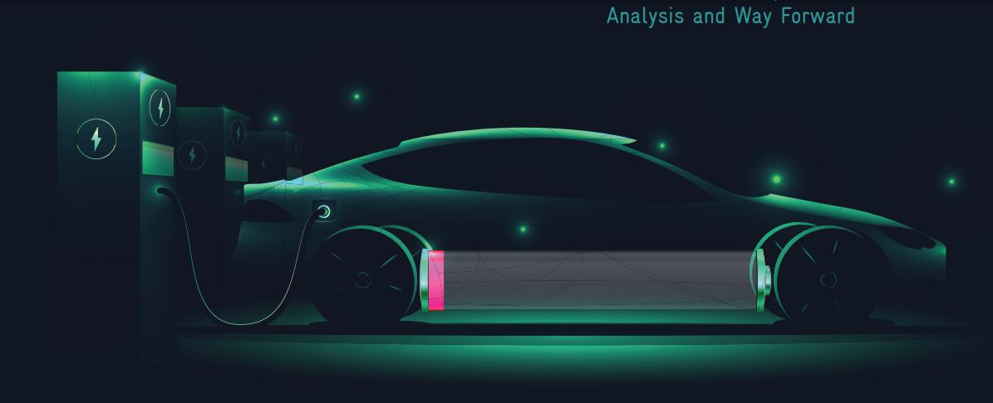
EV Market Analysis: India

Slide 2
Problem Statement

Slide 3
Atliq Motors EV Expansion to India
AtliQ Motors is an automotive giant from the USA specializing in electric vehicles (EV).
In the last 5 years, their market share rose to 25% in electric and hybrid vehicles segment in North America.
As a part of their expansion plans, they wanted to launch their bestselling models in India where their market share is less than 2%.

Slide 4
Objective

Slide 5
Objective
A detailed Market Research and Competitor Analysis of existing EV/Hybrid market in India
Identify Market Leaders
Analyse Seasonal Trends
Identify High-Growth Regions
Identify Declining Markets

Slide 6
Let’s Start

Slide 7
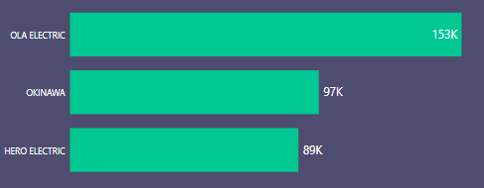
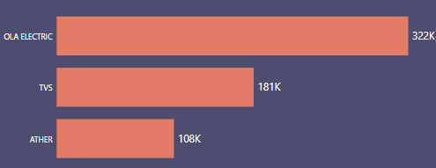
1. Top 3 and bottom 3 Makers for the fiscal years 2023 and 2024 (number of 2-wheelers sold)
Insight(s)
Top 3
(2023)
OLA leading the market for last 2 year. With 110% increase in sales from FY2023 to FY2024
New makers like TVS and Ather entered in the top 3 in last year.
Top 3
(2024)

Slide 8
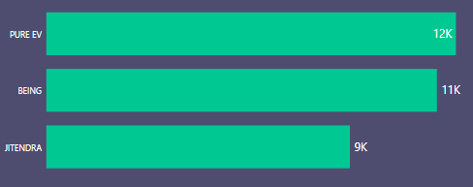
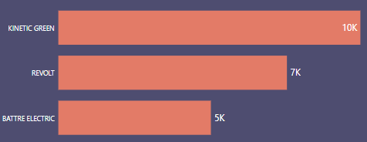
1. Top 3 and bottom 3 Makers for the fiscal years 2023 and 2024 (number of 2-wheelers sold)
Insight(s)
Bottom 3
(2023)
Kinetic Green and Battre Electric started selling from this year, therefore numbers could be low
While Revolt is selling since 2022 but facing a decrease in sales from Q1’23.
Bottom 3
(2024)

Slide 9
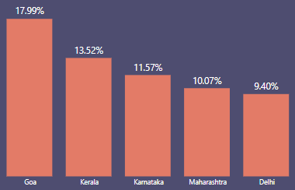
2. Top 5 states with the highest penetration rate in 2-wheeler and 4-wheeler EV sales in FY 2024.
2-Wheeler
Insight(s)
Goa leading with highest penetration rate of 17.99%, which is ~3 times the average penetration rate in 2 wheeler category.
All top 5 states have higher penetration rate that the average penetration rate in 2 wheeler category.

Slide 10
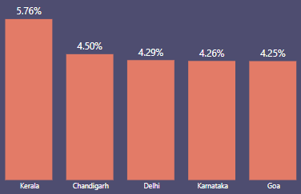
2. Top 5 states with the highest penetration rate in 2-wheeler and 4-wheeler EV sales in FY 2024.
4-Wheeler
Insight(s)
Kerala leading with highest penetration rate of 5.76%, which is ~2.5 times the average penetration rate in 4 wheeler category.
All top 5 states have higher penetration rate that the average penetration rate in 4 wheeler category.

Slide 11
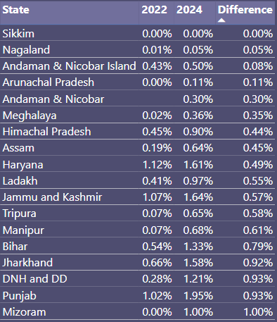
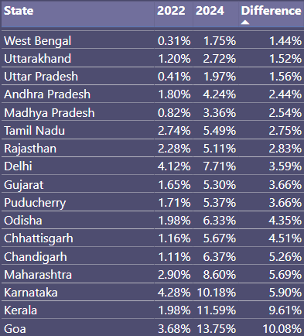
3. States with Negative penetration (decline) in EV sales from 2022 to 2024?

Slide 12
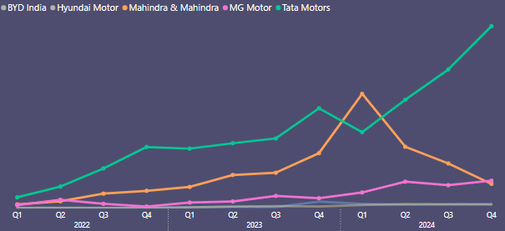
4. What are the quarterly trends based on sales volume for the top 5 EV makers (4-wheelers)
from 2022 to 2024?
Insight(s)
For TATA sales increased by 300% from FY2022 to FY2024
For Mahindra sales increased by 475% from FY2022 to FY2024
For MG Motor sales increased by 700% from FY2022 to FY2024

Slide 13
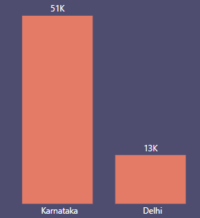
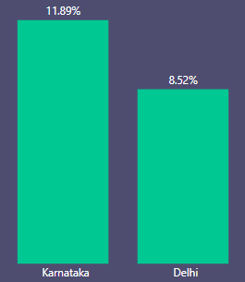
5. How do the EV sales and penetration rates in Delhi compare to Karnataka for 2024?
EV Sales
Penetration Rate
Insight(s)
Karnataka has 292% more sales than Delhi
Also, Karnataka has ~2% points more penetration rate than Delhi

Slide 14
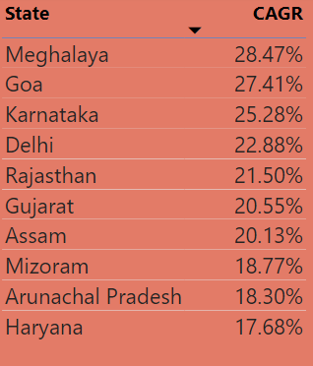
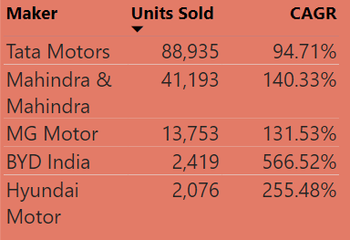
6. List down the compounded annual growth rate (CAGR) in 4-wheeler units for the top 5 makers from 2022 to 2024.
7. List down the top 10 states that had the highest compounded annual growth rate (CAGR) from 2022 to 2024 in total vehicles sold.

Slide 15
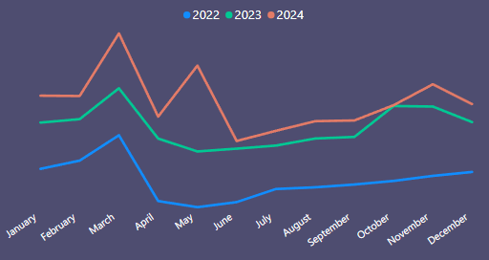
8. What are the peak and low season months for EV sales based on the data from 2022 to 2024?
High
Low
Insight(s)
From sales trend , clearly visible that March is the peak month with most sales in each year
And April & May are the low month with least sales each year.

Slide 16
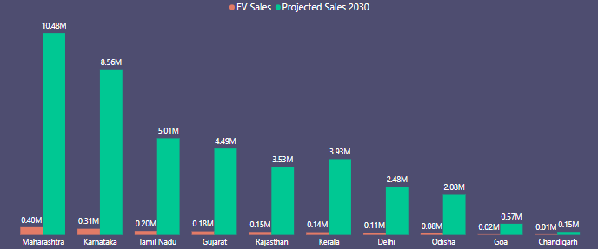
9. What is the projected number of EV sales (including 2-wheelers and 4 wheelers) for the top 10 states by penetration rate in 2030, based on the compounded annual growth rate (CAGR) from previous years?
Here is the projected sales :

Slide 17
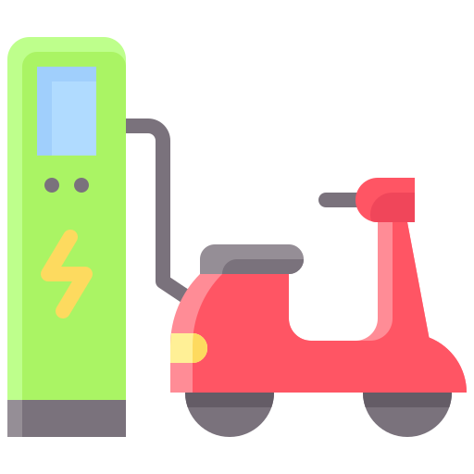
10. Estimate the revenue growth rate of 4-wheeler and 2-wheelers EVs in India for 2022 vs 2024 and 2023 vs 2024, assuming an average unit price.
2-Wheelrs -> 85,000
4-Wheelers -> 15,00,000
Insight(s)
2-Wheelers
2022 vs 2024
269%
From FY2022 to FY2024
Revenue increased by ₹21 Billion to ₹79 Billion
From FY2023 to FY2024
Revenue increased by ₹61 Billion to ₹79 Billion
2-Wheelers
2023 vs 2024
28%

Slide 18
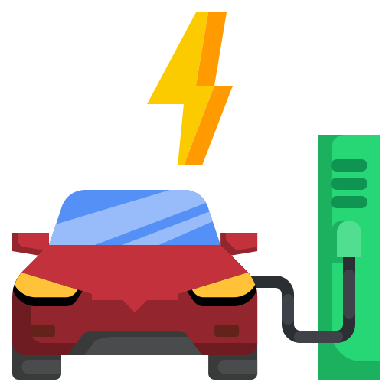
10. Estimate the revenue growth rate of 4-wheeler and 2-wheelers EVs in India for 2022 vs 2024 and 2023 vs 2024, assuming an average unit price.
2-Wheelrs -> 85,000
4-Wheelers -> 15,00,000
Insight(s)
4-Wheelers
2022 vs 2024
368%
From FY2022 to FY2024
Revenue increased by ₹27 Billion to ₹130 Billion
From FY2023 to FY2024
Revenue increased by ₹71 Billion to ₹130 Billion
4-Wheelers
2023 vs 2024
83%

Slide 19
Secondary Research

Slide 20
1. What are the primary reasons for customers choosing 4-wheeler EVs in 2023 and 2024 (cost savings, environmental concerns, government incentives)?
Potential reasons :
Quick Fact
One will spend somewhere between Rs 7-8 Rs per kilometer in a small petrol car.
In an EV, it costs approximately Rs 1 to 1.5 per kilometer.
EVs create less pollution and are better for the planet.
They are cheaper to run than traditional cars, especially with rising fuel prices.
Many governments offer tax benefits or incentives to encourage people to buy EVs.
EVs are becoming more efficient, have longer ranges, and offer better features.
If you drive for 10,000Kms every year for the next 6 years, you spend :
- electric car = around Rs 1 lakh. - petrol car = around Rs 5.5 to 6 lakhs

Slide 21
2. How do government incentives and subsidies impact the adoption rates of 2-wheelers and 4-wheelers? Which states in India provided most subsidies?
Government incentives and subsidies are very helpful for the adoption of electric vehicles (EVs) in India.
They make EVs more affordable by reducing the cost difference between EVs and traditional fuel vehicles.
Maharashtra
Gujarat
Meghalaya
Two-wheeler: Maximum up to Rs. 25,000
Three-wheeler: Benefits up to Rs. 30,000
Four-wheeler: Maximum up to Rs. 2.5 lakh
Two-wheeler: Maximum up to Rs. 20,000
Three-wheeler: Benefits up to Rs. 50,000
Four-wheeler: Maximum up to Rs. 1.5 lakh
Two-wheeler: Maximum up to Rs. 20,000
Three-wheeler: N/A
Four-wheeler: Maximum up to Rs. 60,000

Slide 22
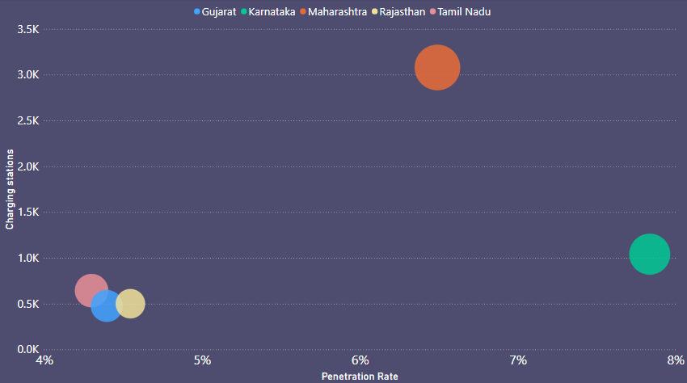
3. How does the availability of charging stations infrastructure correlate with the EV sales and penetration rates in the top 5 states?
Maharashtra has the highest penetration rate and a significant sales, indicating a strong impact of charging stations.
Karnataka shows a relatively high penetration rate but with a moderate change in sales compared to Maharashtra.
Tamil Nadu & Gujarat have similar penetration rates with moderate changes in sales, suggesting a balanced impact.

Slide 23

4. Who should be the brand ambassador if AtliQ Motors launches their EV/Hybrid vehicles in India and why?
Shahid Kapoor has a significant following among the younger generation who are increasingly interested in sustainable and eco-friendly products.
Known for his fitness regime and healthy lifestyle, Shahid Kapoor aligns well with AtliQ Motors' focus on sustainable and healthy transportation.
Shahid Kapoor has been involved in various environmental initiatives, demonstrating his commitment to sustainability.
This aligns with AtliQ Motors' focus on electric and hybrid vehicles, which are considered more environmentally friendly than traditional gasoline-powered cars.

Slide 24
5. Which state of India is ideal to start the manufacturing unit? (Based on subsidies provided, ease of doing business, stability in governance etc.)
Gujarat is the ideal state for AtliQ Motors to establish its manufacturing unit in India.
Here's why:
Subsidies and Incentives:
Gujarat benefits significantly from the Production-Linked Incentive (PLI) scheme, especially for the automotive sector, offering substantial subsidies.
Ease of Doing Business:
Infrastructure:
The state has excellent road and rail connectivity, vital for the automotive industry.
Skilled Workforce: Gujarat has a large pool of skilled labor, particularly in manufacturing.
Stability in Governance:
Political Stability: The state has a stable political environment, crucial for long-term investments.
Law and Order: Gujarat offers a safe and secure environment for businesses.
While other states like Maharashtra and Tamil Nadu offer competitive advantages, Gujarat's combination of subsidies, business-friendly environment, and stability makes it the best choice for AtliQ Motors.

Slide 25

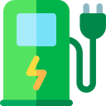

6. Top 3 recommendations for AtliQ Motors.
Recommendation 1:
Recommendation 2:
Recommendation 3:
For Manufacturing the ideal state could be Gujarat or Maharashtra due several government incentives and subsidies.
Also, both the states are very business friendly and have high infrastructure.
The availability of charging stations are going to be very important.
Make sure to availability of charging stations are good in each states.
Goa, Karnataka, Delhi, Maharashtra, and Kerala are prime states for launching new vehicles due to their high penetration rates
Helpful for initial launches'

Slide 26
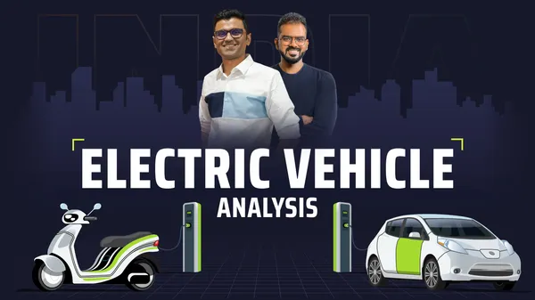
Special Thanks to :
Dhaval Patel
Hemanand Vadivel

Slide 27
Thank You !

